Slide 1
Data structures and algorithm
Dr. Seemab Latif
Lecture No. 1
4th October, 2010

Slide 2
Contact Information
Instructor: Dr. Seemab Latif
Email: seemab@mcs.edu.pk
Office hours: Tuesdays, 11:00 - 13:00, Lab 2

Slide 3
Books to Follow
Introduction to Data Structures in C by Ashok N. Kamthane
Data Structures and Algorithms by A. V. Aho, J. E. Hopcroft, J. D. Ullman
Data Structures Using C and C++ by Y. Langsam, M. J. Augenstein, A. M. Tenenbaum
Algorithms in C++ by Robert Sedgewick

Slide 4
Grading
Theory
Quizzes ---------------10%
Assignments-----------10%
Mid Term-------------- 30%
Final-------------------- 50%
Labs
Assignments/Exercises and Project------ 50%
Mid term------------------------------ 20%
Final----------------------------------- 30%
Late Policy: Usually each assignment has oneweek time to finish; Assignments will not be accepted later without the express permission of the instructor or the teaching assistant.

Slide 5
Some General Comments
Encouragement to ask questions during class
Without your feedback, it is impossible for me to know what you don’t know
There is no reason not to ask questions during class
Of course, you could also send email, or meet in person
Encouragement to read course material prior to class

Slide 6
Introduction to Data Structure
A data structure is a particular way of storing and organizing data in a computer so that it can be used efficiently

Slide 7
What is Data Structure?
Data structure is a representation of data and the operations allowed on that data.
A data structure is a way to store and organize data in order to facilitate the access and modifications.
Data Structure is the method of representing of logical relationships between individual data elements related to the solution of a given problem.

Slide 8
Fundamental Data Structures
Basic Data Structures
Linear Data Structures
Non-Linear Data Structures
Arrays
Linked Lists
Stacks
Queues
Graphs
Trees
Hash Tables

Slide 9
Linear Data Structures
A data structure is said to be linear if its elements form a sequence or a linear list.
Examples:
Arrays
Linked Lists
Stacks
Queues

Slide 10
Non-Linear Data Structures
A data structure is said to be non-linear if its elements does not form a sequence or a linear list.
Examples:
Trees
Graphs
Hash Tables
Each element may be connected with two or more other nodes or items in a non-linear arrangement.

Slide 11
Operations on Data Structures
Traversal: Travel through the data structure
Search: Traversal through the data structure for a given element
Insertion: Adding new elements to the data structure
Deletion: Removing an element from the data structure
Sorting: Arranging the elements in some type of order
Merging: Combining two similar data structures into one

Slide 12
Linear Data Structures
Arrays
Linked List
Stacks
Queues

Slide 13
Arrays
A sequence of n items of the same data type that are stored contiguously in computer memory and made accessible by specifying a value of the array’s index.
Properties:
fixed length (need preliminary reservation of memory)
contiguous memory locations
direct access
Insert/delete
a[0] a[1] a[2] a[3] a[4] a[5] a[6] a[7] a[8] a[9]
1 2 3 4 5 6 7 8 9 10
Array a with 10 integer elements

Slide 14
Linked List
A sequence of zero or more nodes each containing two kinds of information: some data and one or more links called pointers to other nodes of the linked list.
Properties
dynamic length
arbitrary memory locations
access by following links
Insert/delete
Types of Linked List
Singly linked list (next pointer)
Doubly linked list (next + previous pointers)

Slide 15
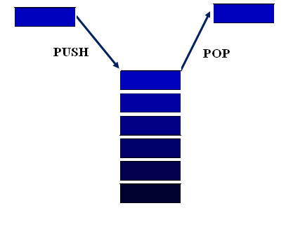
Stacks
A stack is a data structure that uses last-in, first-out (LIFO) ordering and allows reading and writing on the top element only.
Properties
insertion/deletion can be done only at the top
LIFO
Two operations
Push
Pop

Slide 16
Queues
Collection with access only to the item that has been present the longest
Properties
Insertion/enqueue from the rear (back) and deletion/ dequeue from the front.
FIFO
Two operations
Enqueue
Dequeue
Front
20 30 10 60 57 29
Back

Slide 17
Non-Linear Data Structures
Graphs
Trees
Hash Tables

Slide 18
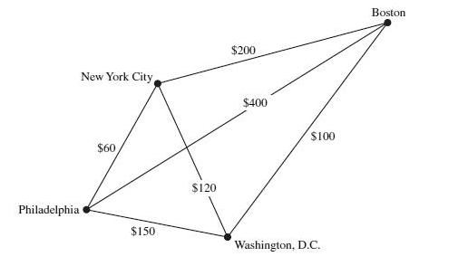
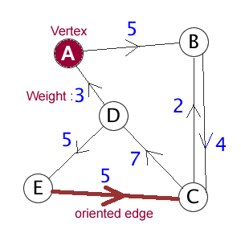
Graphs
Formal definition: A graph G = <V, E> is defined by a pair of two sets: a finite set V of items called vertices and a set E of vertex pairs called edges.
Undirected and directed graphs (digraphs).
Complete, dense, and sparse graphs
Undirected Graph
Directed Graph

Slide 19
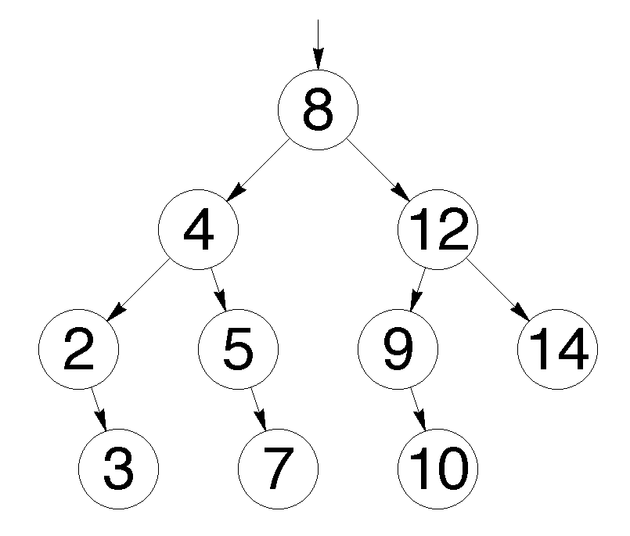
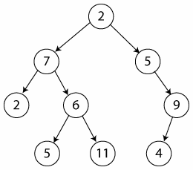
Trees
A Tree is a way of representing the hierarchical nature of a structure in a graphical form.
Properties of trees
Root Node
Child Node
Parent Node
Leave Node
Types
Unordered Tree
Binary Tree is an ordered tree data structure in which each node has at most two children.
Unordered Tree
Binary Tree

Slide 20
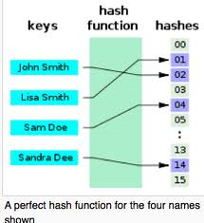
Hash Tables
A hash table is a data structure that uses a hash function to map identifying values, known as keys (e.g., a person's name), to their associated values (e.g., their telephone number).

Slide 21
Summary
A data structure is a particular way of storing and organizing data in a computer so that it can be used efficiently.
Linear Data Structures
Arrays
Linked List
Stacks
Queues
Non Linear Data Structures
Graphs
Trees
Hash Tables

